Slide 1

Department Of Computer Science

Slide 2
Software Requirement Specification Project Title (Speech2Face)
Shahzaneer Ahmed
SP21-BCS-087
Shayan Zameer
SP21-BCS-088
Supervisor:
Mr. Tehseen Riaz Abbasi
Department Of Computer Science
Submission Date: 23 Dec 2022

Slide 3
Project Category
Based on your project type, write the appropriate Category / Categories of your project.
B- Web Application
C- Problem Solving and Artificial Intelligence
E- Smartphone Application

Slide 4
Research Based Project
Yes

Slide 5
Introduction
Speech2Face is a Research and Development-based Product with the main functionality to convert the voice into vector form and the vector form to image form and thus assisting in providing insights about the details of the person whose voice is under observation.
It is developed using different technologies and Deep Learning and machine learning techniques will be used. The Image generated can be modified in accordance with the users’ perspective.
The Software Test Plan Document will provide a comprehensive overview of all Test Plan stages, as well as the final product. The STP report describes the many forms of testing that are carried out on various areas of the system. The testing of modules, components, and features at various phases of development, such as unit testing, integration testing, system testing, and so on, will be briefly discussed.
General user: They can retrieve their images from their voice notes.
Security Agencies: It Can help them identify the criminals and speed up the process of resolving complex cases.

Slide 6
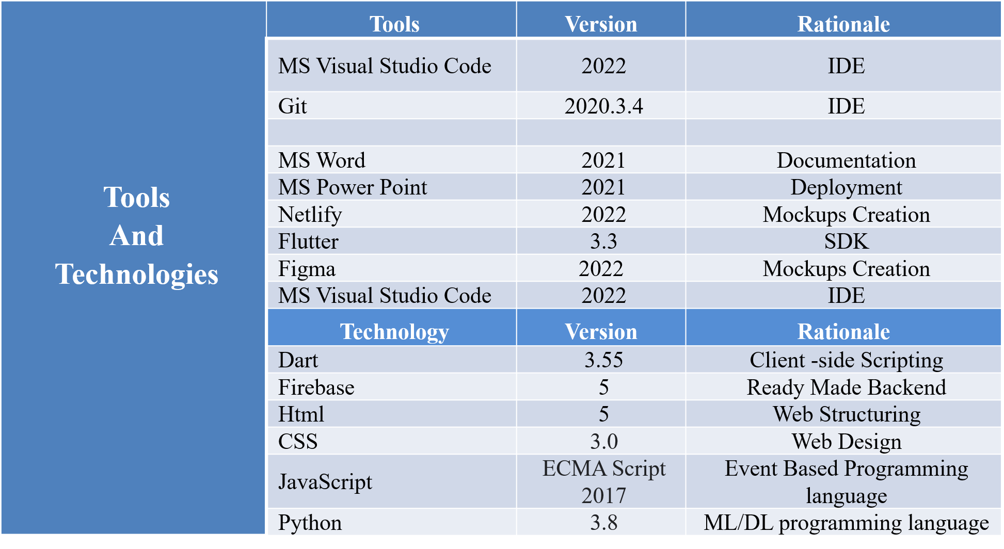
Tools and Technologies
Following tools and technologies will be implemented in this Application:

Slide 7
Scope
Speech2face is a web and mobile application-based software that is mainly built to recognize the face general structure, ethnicity and gender with the audio waves. Currently there is no full fledge software in the world that helps in this regard although there are deep learning libraries on which much work is done in the past.
It was nearly impossible to predict the appearance of some person with his/her voice. But Artificial Intelligence has made it.

Slide 8
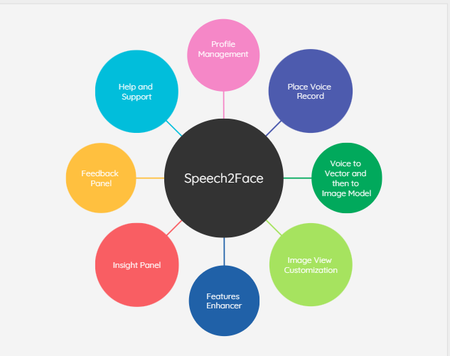
Context Diagram of Proposed Project
Context Diagram Of Speech2Face

Slide 9
Modules
The modules of the project are listed below:
Module 1: Profile Management
Module 2: Place Voice Record
Module 3: Sound to Face Vector Model
Module 4: Face-Vector to Face-Image Model
Module 5: Image View Customization
Module 6: Features Enhancer.
Module 7: Insight Panel
Module 8: Feedback panel
Module 9: Help and Support

Slide 10
Intended Audience
Intended Audience includes:
Client/users
Professors
Security Agency Analysts
Project Committee Members

Slide 11
Test Items
The Items to be tested are given below:
Use Cases of each module
Requirement Specifications
Design Specifications
User Guides
Operation Manuals
Installation Manuals
Usability
Performance
Security
Compatibility
Reliability

Slide 12
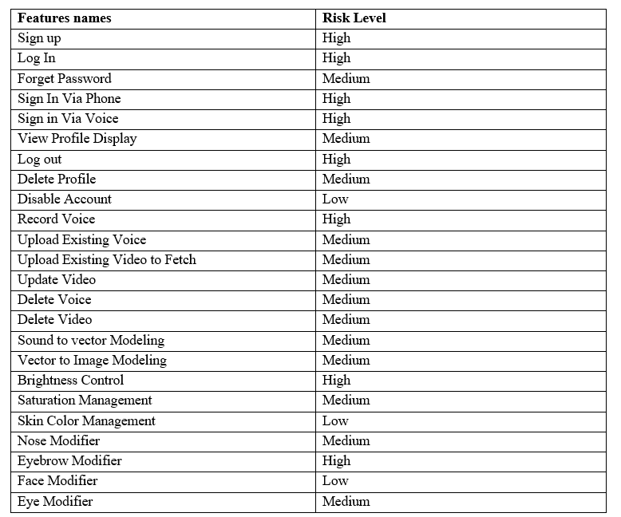
Features to Be Tested

Slide 13
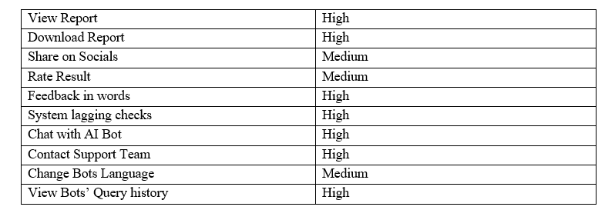
Features to Be Tested

Slide 14
Item Pass/Fail Criteria
Unit Level:
Test Passing: The test is declared passed if 80% of the test cases are completed and tested with less than 5% of defects rate.
Test Failure: The test is declared failed if 80% of the test cases are completed and tested with more than 5% of defects rate.
Low Level Tests:
Test Accomplishment: Low level tests will be accomplished if 90% of the plans are successfully completed without major bugs and defects.
Bugs Acceptability: Maximum number of 6 bugs are allowed in the plan. The test with medium or major bugs are failed.

Slide 15
Item Pass/Fail Criteria
High Level Tests:
Test Accomplishment: The high level test are said to be completed when the system runs successfully and efficiently and produce the required result with minimal bugs.
Bugs Acceptability: Minor bugs and defects are acceptable if they do not cause the failure of the system or crashing.

Slide 16
Item Pass/Fail Criteria
Application
The application will receive a Passed status if it accomplishes in producing more than 85% accurate results.
The application will receive a failed status if it produces less than 85% accurate results.
Data Conversion
Success criteria for data conversion are outlined in the Data Conversion Plan.

Slide 17
Test Deliverables
Test deliverables of the document are:
Test plan
Data gathering, testing models and philosophy, experiments, and an arrangement for directing tests are all important for this interaction.
Test design specifications
The test plan-close to the system used to make and run the tests are associated with this deliverable.
Test case specifications
The conditions and criteria for the results, along with the specifications of the functionalities that were tested, are included.
Test procedure specifications
It incorporates the picked sort of testing strategy. For instance, our picked type is dim box testing since it remembers effective and exhaustive testing for both interior and outer degree of the item.
Test item transmittal reports
List of entities to be tested are included.
Test logs
The test data and received outcomes are included.
Test Incident Reports
Any defects/ bugs and abnormality found in behavior of the app are included.
Test Summary reports
A brief overview of whole procedure with statistical data is included.

Slide 18
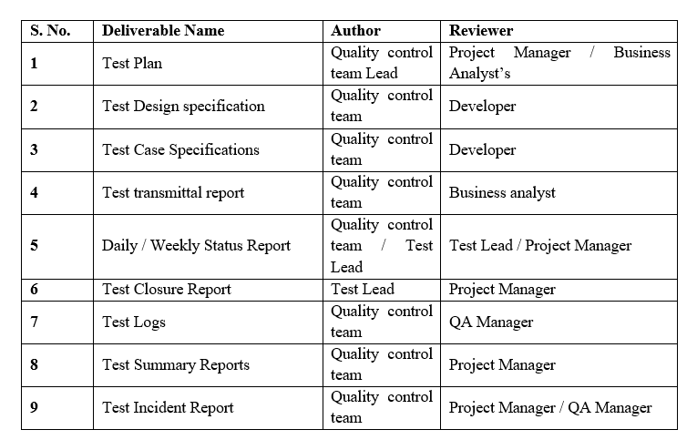
Test Tasks

Slide 19
Environmental Needs
Following are the environmental needs for carrying out our test plan:
Stable internet connection for both mobile and web applications
Devices with Android 6 and above, or iOS 11 and above.
Web browsers that support HTML 5.
The Data should already be trained for the desired region and race of humans.

Slide 20
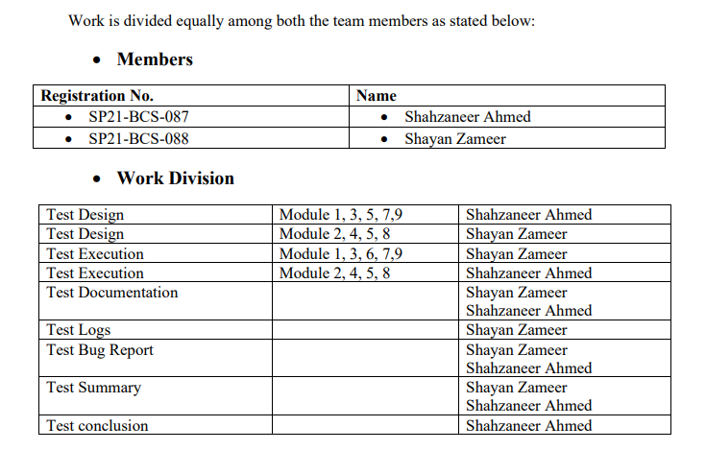
Responsibilities

Slide 21
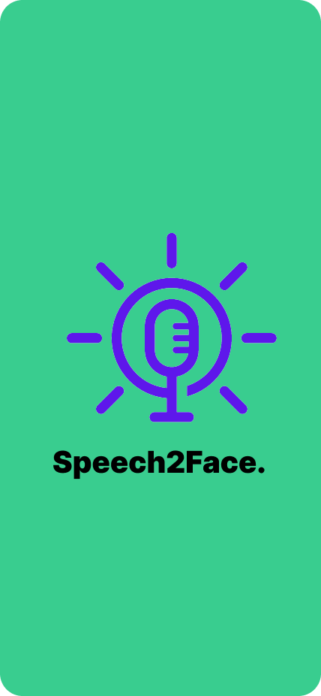
User Interfaces
Interface-1: Splash Screen of Mobile application

Slide 22
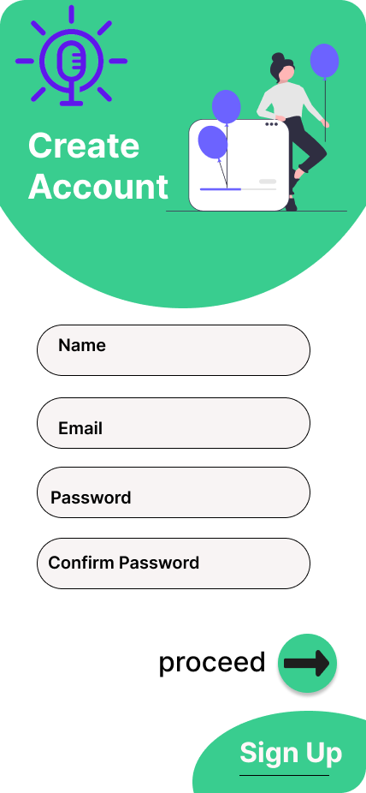
User Interfaces
Interface-2: Signup Screen of Mobile application

Slide 23
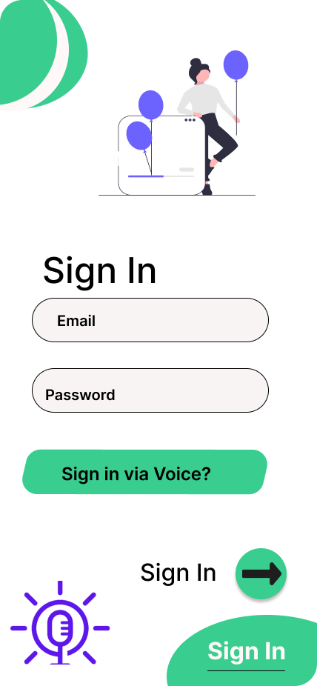
User Interfaces
Interface-3: Sign in Screen of Mobile application

Slide 24
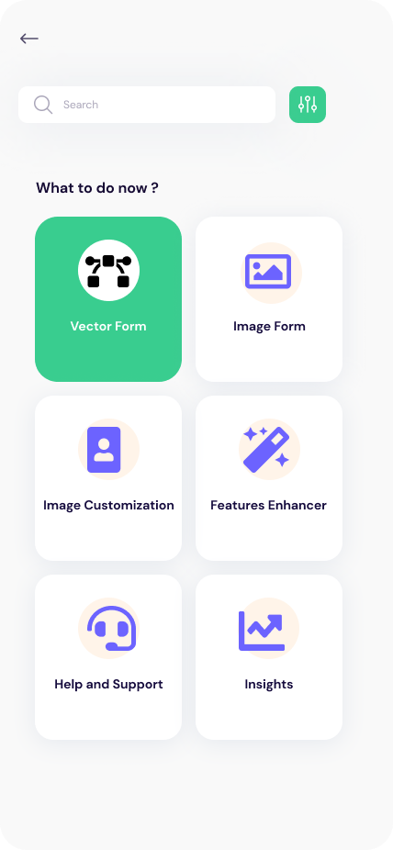
User Interfaces
Interface-4: Home Screen of Mobile application

Slide 25
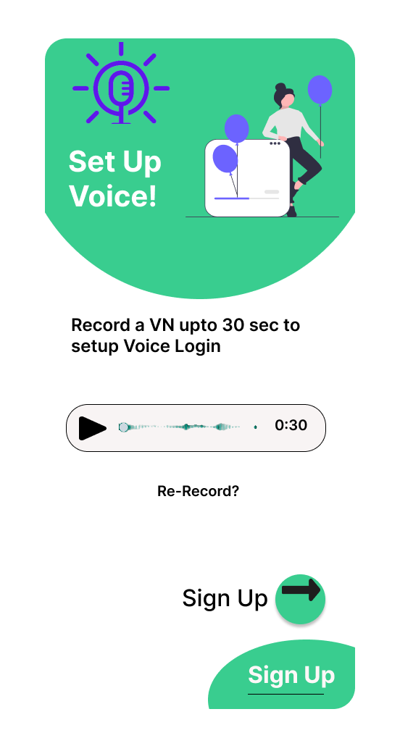
User Interfaces
Interface-5: Add Voice Screen of Mobile application

Slide 26
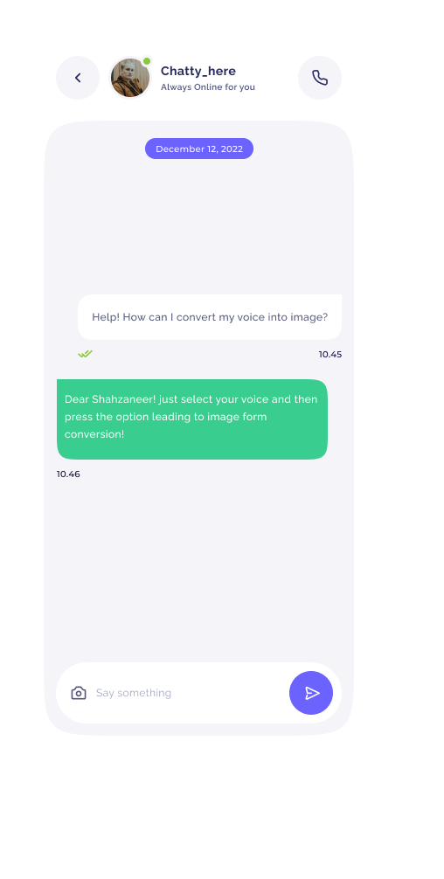
User Interfaces
Interface-6: Chat Box Screen of Mobile application

Slide 27
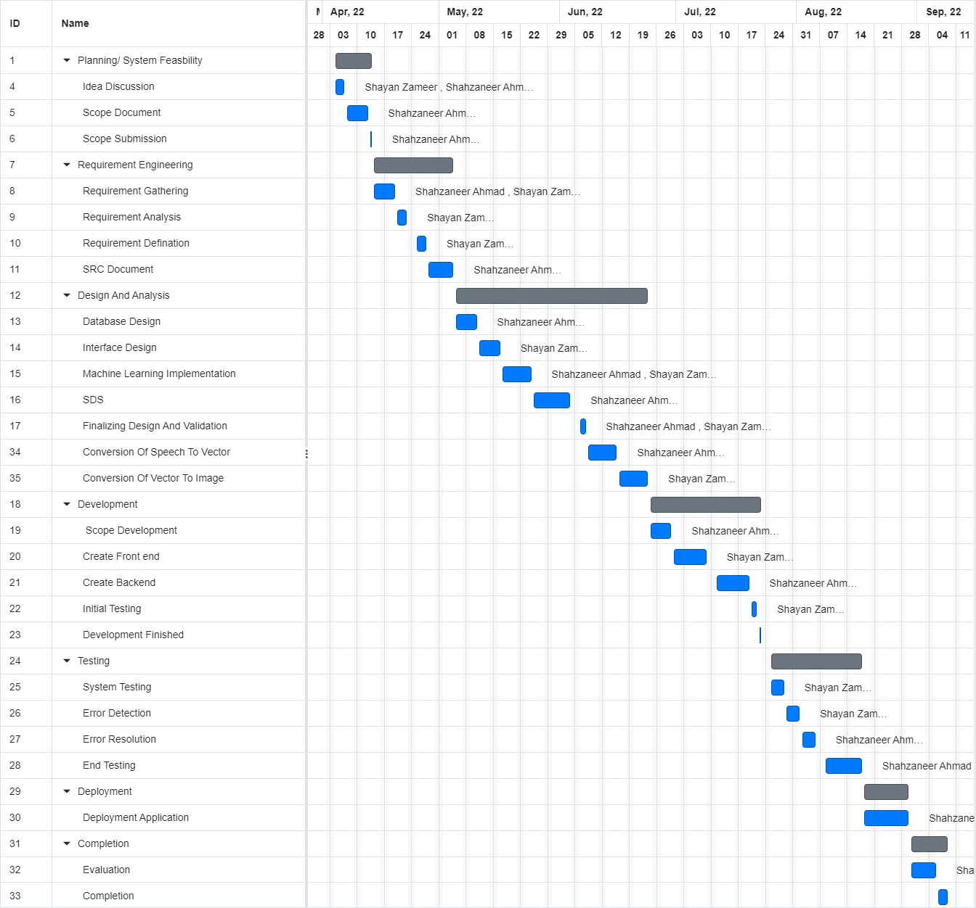
Gantt Chart
Gantt Chart is provided Below:

Slide 28
Conclusion
This archive assumes a fundamental part to guarantee the rightness, viability, and dependability of programming items. The framework is completely confirmed and approved to limit item disappointments. This record contains exact data, guaranteeing that partners get precise test reports to appreciate the item's abilities completely.

Slide 29
References
Related Systems:
https://www.github.com/topics/sound-classification.
https://speech2face.github.io/
Google Facenet
Youtube Resources:
https://www.youtube.com/watch?v=aKYlSIs3UDY&t=334s

Slide 30

Questions and Answers

